Slide 1

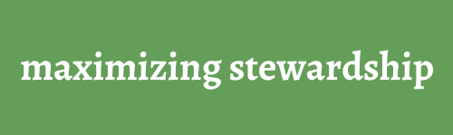
Estate Planning
Session 2
Brad & Andrea Jack, Lyle Weber © 2022

Slide 2

Helping Elderly Parents
          Monthly Expense sheet
          Document Organizer handout
          List of Passwords and Institutions.
Notes:
Planning to assist elderly parents is no small task. You will need to know their monthly expenses that may include the names and numbers of their doctors and pharmacy information to include copies of their insurance cards. To manage their affairs, you will also need to have access to their passwords.

Slide 3
Your Parent’s Budget
What are their income sources?
What are their expenses?
Don’t forget expenses that don’t happen every month, like the neighborhood association or annual dues or insurance paid other than monthly.
Notes:
Just as you hopefully have a written budget for your family, you will need to have one for your parents, detailing their monthly, quarterly and annual expenses.

Slide 4
Your Parent’s Contacts
Important Phone numbers: Doctors and Dentists
Financial Advisors, Estate Attorney & CPA
Their closest friends
Notes:
Once it is time to step in and help, make an appointment with professionals where they have relationships, to apprise them of the situation and ask for advice.

Slide 5
Financial Institutions
Obtain legal advice from an attorney, Board Certified in Probate and Estate Planning.
Ask how accounts should be registered?
Who will watch to ensure a family member or friend doesn’t steel from an account?
Notes:
It is significant to note that the primary source of elderly theft is often a relative or close friend because they have access.

Slide 6
Passwords and Accounts
Do you have access if they want you to?
Where is the list of passwords?
Is there someone they do not want to have access?
Notes:
Is there someone they do not want to have access to their accounts? On the other hand, who is trustworthy in the family and manages their own affairs well?

Slide 7
Medicare Selections
Choosing the best Medicare plan for your parents.
When can the plan be changed to a different plan?
What Supplemental Policies are best?
Medicare.gov
ConsumerReports.org
Notes:
The window of time to change Medicare or drug plans is in the fall, normally between October 15 and December 7.

Slide 8

How can someone designate another person to act as their legal agent?
Power of Attorney, broad or limited
Medical Power of Attorney for healthcare
Medical Directive to Physician, or living will for quality of life and free from pain.
DNR - “do not resuscitate”
Notes:
Do you know where these documents are located? Do your parents need to have these created? What about your own documents?

Slide 9
Legal Documents
In the first session, we talked about Wills.
What is a Trust?
Notes:
What is the difference between a last will and testament and a trust?

Slide 10
Three basic options to choose from:
No Will
                Having a Will
                A Will & a Trust
Notes:
When you die, you will fall into one of three categories: No Will, having a will or having both a will and a trust.

Slide 11

Components of a Trust
The one who creates it
What is held in a trust?
Who manages it?
The purpose: for the beneficiary
Notes:
What are the basic components of a trust?

Slide 12

A trust might be preferred in some states
when…
Notes:
Do you need a trust? It depends…

Slide 13

You own property in another state
Influence from future heirs
Avoids probate
Estate exceeds $12.92 Million (2023)
You have a child or heir with a disability
Previously married
Notes:
It may depend on having property outside your home state or you have a sizable estate. There are other situations as well.

Slide 14

Trust Ownership
The title to property must be transferred into a trust
for it to take effect.
Trusts and Creditors
Creditors can win lawsuits against you and your trust.
It is considered part of your estate when you die.
Notes:
A trust does not protect your estate from creditors. Please consult a board-certified probate and estate attorney for more information.

Slide 15
Notes about Living Trusts
A trust can be contested
May cost money to manage
Does not protect against creditors
Does not escape federal estate tax thresholds
Could be included in Medicare thresholds
Notes:
Although a trustee, the manager of the trust, generally has the power to distribute assets, trusts may still be tapped for other things.

Slide 16
a. Avoids probate
b. Less expensive to administer
c. May have fewer delays
d. Privacy – no public record
e. Flexibility
f. May avoid problems of Joint Tenancy
g. Guardianship can be nominated
h. Can help in the event of incapacitation
i. Distribution timing up to trustee
j. Helpful with larger estate planning
Trust Benefits
Notes:
Joint Tenancy is the holding of an estate or property jointly by two or more parties, the share of each passing to the other or others on death. So when one person passes, the other automatically gets the property held this way. But there is also the potential for assets to be frozen, and loss of control over the distribution of assets after death.

Slide 17
If I have a Trust
do I need a Will?
Yes, it is a backup device for what is not in the trust.
The term"Per Stirpes” is the normal distribution hierarchy of assets to heirs.
Notes:
Is having a trust without a will sufficient? You also need a will.

Slide 18
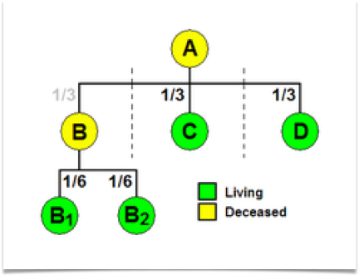
“Per Stirpes” Distribution
Notes:
Think of this as a flow chart, instructing who gets what based on family relations.

Slide 19
Pets can’t own property.
Leave it to a good home.
Can my pet be an heir?
Notes:
This may depend on your home state, but where this presentation was written, it is a good idea to let your friend or relative know to come get Fido and give him the forever home he deserves when you pass away.

Slide 20
Federal Estate
Taxes
Thresholds in 2023
$12.92 million per single
$25.84 million per couple
    40% taxes above thresholds
    (Some states also have Estate Taxes)
Notes:
If you have this problem, please, please see an estate planning attorney, a financial advisor and a CPA to jointly work out a plan together.

Slide 21

Next Session
Providing for your family
The income value of a Nest Egg
Life Insurance
Questions?
Brad & Andrea Jack, Lyle Weber © 2022
https://maximizingstewardship.net

