Slide 1


      Session 3 I Timothy 5:8
      Providing for your family
Brad & Andrea Jack, Lyle Weber © 2022
Notes:
Ask someone to read 1 Timothy 5:8

Slide 2

What can I expect to
safely earn from our nest egg?
Take no more than 4% max in any one year to make the money last.
Notes:
Someone asked, how much do I need, to live without earning an income? The answer is: “It depends!” Do you have military, civil service or teacher’s retirement? What are your monthly living expenses including, well, everything?

Slide 3

Rule of thumb:
Take no more than 4% max in any one year to make the money last.
    With $ 250,000
$ 10,000 per year
    $ 1.8 m
$ 72,000 year
    $ 2.0 m
$ 80,000 year
    $ 2.2 m
$ 88,000 year
    Need $ 2.5 m
for $100,000 per year
Notes:
Just to use round numbers, let’s say you have 1 million in your retirement savings. At 4%, you can plan to spend $40,000 per year from your net egg. This assumes that it is invested and diversified wisely.

Slide 4
How much will your need for cash
change if your spouse passes away?
Approx. 80% is needed.
Some costs will go down, such as:
Employment costs of the wage earner
Retirement Contributions
Living Expenses (5% to 7% )
Discretionary expenses
2nd Vehicle Expenses

Slide 5

Minor Children Benefits:
unmarried children who are under 18
Surviving Spouse Benefits:
will not normally receive SS until retirement
Notes:
When you lose your working spouse, social security will help until each child turns 18 years of age. However, the surviving spouse will not have income from social security until their retirement age.

Slide 6
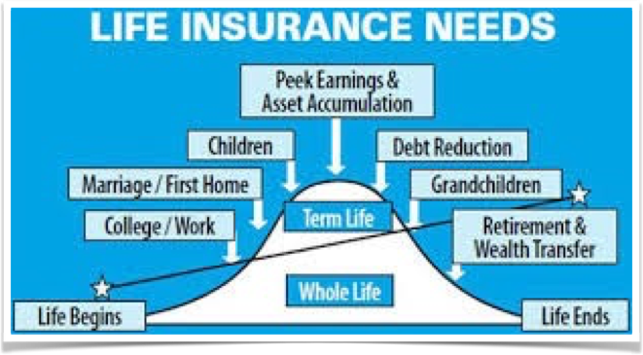
When do you need Life Insurance?
Notes:
When does someone have the highest need for life insurance? Then kids are living at home, you have a mortgage, a car loan and little if any savings.

Slide 7
Leading causes of death
in the USA in 2014
Notes:
Is accidental life insurance enough to provide for your family should the Lord call your number? Accidental death represents a miniscule cause of death compared to other causes. This is why your employer may provide it at a very low cost. What you really need is LIFE insurance.

Slide 8

How much Life Insurance do you need?
                The purpose of life insurance:
                To replace the income
                of the primary bread winner.
                Life insurance needs worksheet
Notes:
I do not sell life insurance. Before you buy it, do your due diligence.

Slide 9


Whole Life Insurance
versus
Term Life Insurance
Notes:
What kind of life insurance should you buy? Whole life or term?

Slide 10
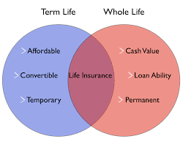

Whole Life accumulates
cash value
payable on death
Term Life
is
pure
insurance
Notes:
When you are young with a family, you need the most life insurance you can afford up to a point. Consider an amount sufficient to pay off the mortgage, send your kids to college and provide enough income for the surviving spouse at least until the kids are grown plus some.

Slide 11



Other types of insurance
might be considered:
Medicare does not pay
Notes:
And then there are other types of insurance. Some of these may be available from your employer at a cheaper group rate.

Slide 12

Pension selections:
Married -
dual life annuity
Single - single life annuity
Notes:
When you make a pension selection, consider the support your family may need after you are gone.

Slide 13

Next Session Eternity and Legacy
Here’s sneak peek!
Francis Chan
video
life span and eternity

Slide 14
Next week:
What will your family legacy
look like?
Questions?
Brad & Andrea Jack, Lyle Weber © 2022
https://maximizingstewardship.net

